Slide 1
Mass Messaging AND DATABASE INPUT
Name: Shams Saniat
ID: 1821848042
Name: MD. Jahirul Islam
ID: 1821368642

Slide 2
Background Study
Sending Message to the Targeted Audience
Removing the traditional manual input to the database
Turning the elements from a image into valuable data
From the image recognition output, the system will keep the information in the database
By using the database, we’ll able to send a message to the targeted people

Slide 3
Proposed System
Capture
Preprocess
Localize
Character Recognition
Segmentation
Connected Component Analyze

Slide 4
Problem Statement
Storing a data manually comes up with a lot of disadvantages like
Human error
Valuable Time waste
Manpower mismanagement
Dynamic image recognition system that can detect the text from an IMAGE
The image recognition system also need to detect the username and their contact no and cancel out the irrelevant data from the environment.
We have to move the scanned text to somewhere in which it will able to put the information to the database automatically
In order to keep the information we need a database system
From the database the system need to send an SMS to the targeted user for marketing purpose or something else
We have data around 30 thousands for this data driven project

Slide 5
Applications
Can be used as an announcement
Can be used as a promotional purpose
Can be used as a spam messaging
Cutting out the labor of inputting data manually
Advance use can be using it at an Supermall, Hospital Management System where a large number of data needs to be inputted in a short time.

Slide 6
Literature review
Python and OpenCV is a deadly combination in the world of computer vision.
After Capturing:
Adaptive thresholding Algorithm using OpenCV need to be applied for binarizing the image
OTSU algorithm
Image Scissoring
Optical Character Recognition

Slide 7
Pytesseract
Open Source OCR Engine sponsored by Google
One of the most accurate open source OCR engine currently available
Lot of it’s written in C and C++

Slide 8

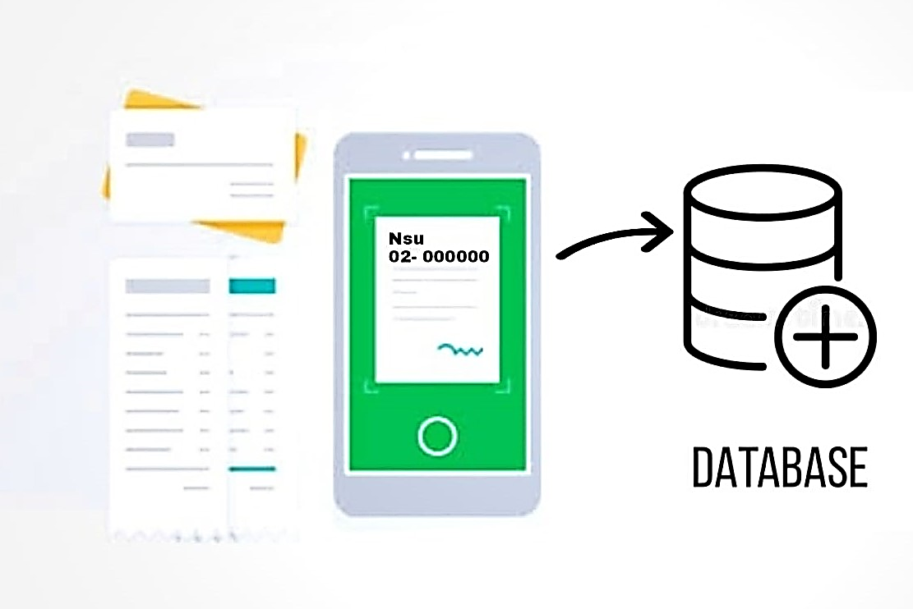
Database

Slide 9
TWILIO MESSAGING API
Twilio API: Access Tokens
Send messages using Twilio REST API
Receive messages to your Twilio phone
Can use Twilio API with – PHP, Python, Java, Node JS

Slide 10
Result & Analysis
Image detects correctly
Binarize image correctly
Saves output on database
Successfully sent SMS

